Slide 1

Analysis of Student Stress Factors: Mayowa Ajayeoba

Slide 2
Agenda
Introduction
About the Dataset
Objectives of the Analysis
Data Analysis Approach
Data Exploration and Visualization
Correlation Analysis
Psychological Factors Analysis
Physiological Factors Analysis
Environmental Factors Analysis
Academic Factors Analysis

Slide 3
About the Dataset
Source
Kaggle
Data length
1100 students
Exploratory Data Analysis
Data Cleaning, missing values, outliers, correlation

Slide 4
Data Overview
Psychological Factor
Physiological Factors
Environmental Factors
Academic Factors
Social Factor
Anxiety Level
Self esteem
Mental health History
Depression
Headache
Blood pressure
Sleep Quality
Breathing problem
Noise level
Living conditions
safety
basic_needs
Academic performance
Study load
Teacher student relationship
Future career concerns
social_support
peer_pressure
Extracurricular activities
bullying

Slide 5
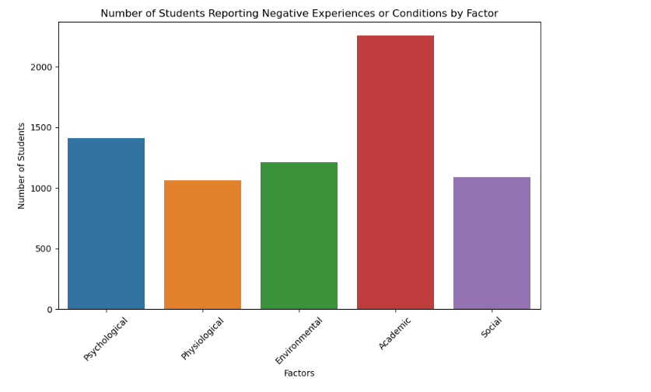
Data Overview
Factor reported to have the highest negative effect on students

Slide 6
Data Analysis Approach
The data analysis approach involved data preprocessing, exploratory data analysis, correlation analysis, and feature importance analysis.
visualization of key metrics, correlation matrix generation, and feature importance ranking.
The approach utilized statistical and machine learning techniques to uncover insights and patterns in the data.

Slide 7
Objectives of the Analysis
Uncover key stress factors affecting students.
1
Provide actionable insights for strategic decision-making.
2
Identify relationships between different factors.
3

Slide 8
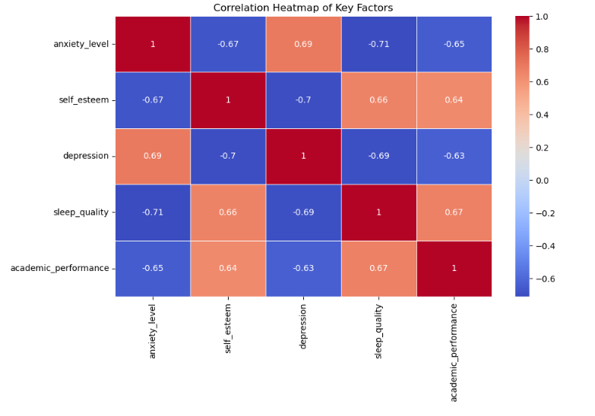
Visualisation
Correlation Heatmap
The correlation analysis reveals strong correlations between anxiety level and academic performance
anxiety level and Sleep quality
anxiety level and Self esteem
sleep quality and depression
Self esteem and depression
Addressing these correlations can significantly impact student stress levels.

Slide 9
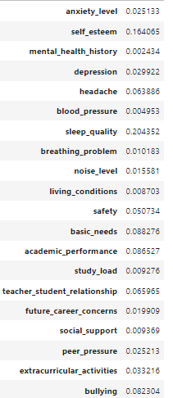
Feature Importance
Sress level
Feature Importance
Random Forest
Environmental Factor
Academic Factor
Social Factor
Basic need
Academic Performance
Bullying

Slide 10

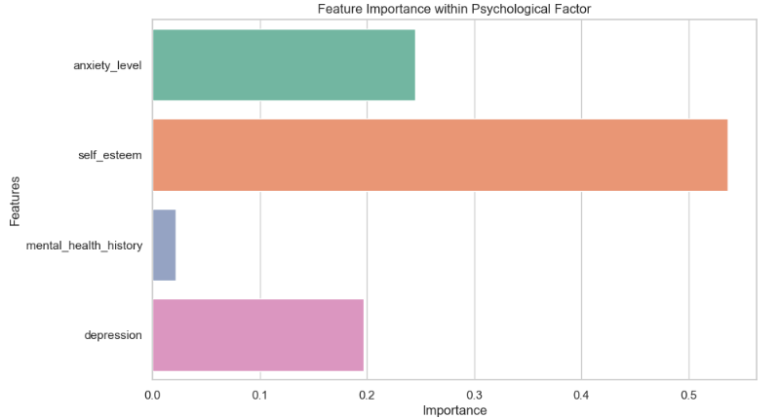
Psychological Factor

Slide 11

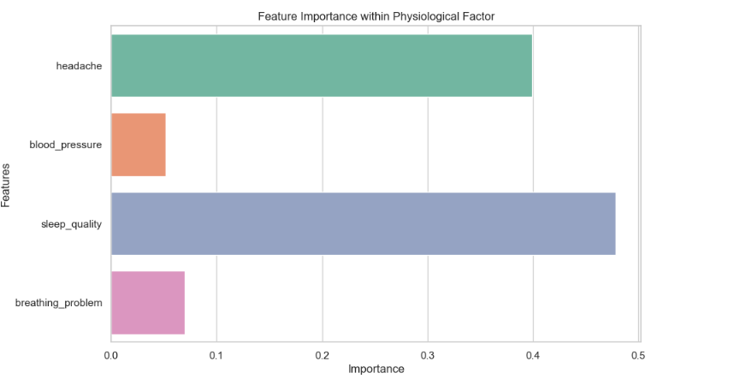
Physiological Factor

Slide 12

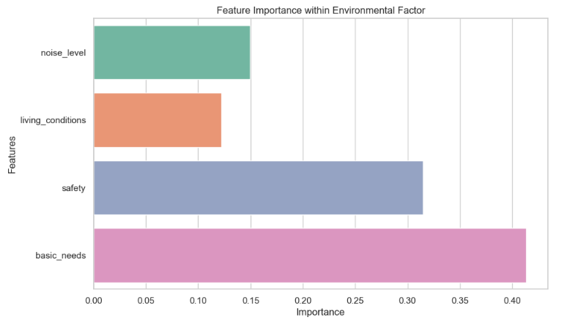
Environmental Factor

Slide 13

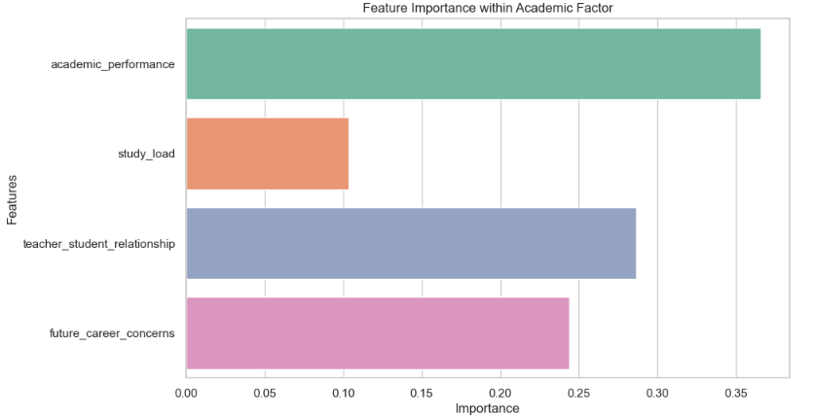
Academic Factor

Slide 14

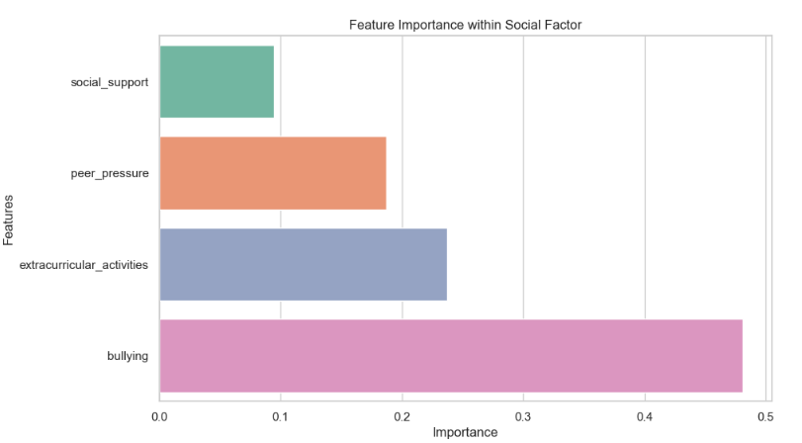
Social Factor

Slide 15

Future Work
Utilize other classification models to compare result

Slide 16


